Slide 1
Basic concepts
Lecture 1a
Course leader: Oleg Sysoev

Slide 2
Course topics
Block 1
Basic concepts in machine learning. Software for ML.
Regression, regularization and model selection
Classification methods
Dimensionality reduction and uncertainty estimation
Support vector machines and kernel methods
Neural networks and deep learning
Block 2
Splines and additive models. High-dimensional problems
Mixture models and online learning. Ensemble methods

Slide 3
Course organization
1 topic= 4-5 lectures +1 lab (2h* 3)+seminar
Course given as
732A99 (9 ECTS): Block 1+Block2
732A68 (9 ECTS): Block 1+Block2
TDDE01 (6 ECTS): Block 1
Labs
SU rooms used
Take around 8h
Individual and group reports
Sharing only ideas in the group, not text or codes
Bring your own laptop if you have – limited amount of computers in the rooms
Deadlines
Individual Special tasks (optional)– if you solve all of them and get at least 14 points at the exam, you get 2 points more.
Published a couple of days in advance – try doing before coming to the first lab session!
Submission via LISAM

Slide 4
Course organization
Lectures
Available as PowerPoint or PDF, normally at LISAM
Seminars
Speaker and opponent groups
Is a laboratory part, obligatory attendance for speakers and opponents
Discussion of the latest lab.
Note: lab assignments are slighlty different for TDDDE01/732A99 but all kinds of assignments may appear at the exam!
Define your group (3 persons) as soon as possible via Lisam (see next two slides)
Difficult to find a group? Put your name in some empty group item

Slide 5
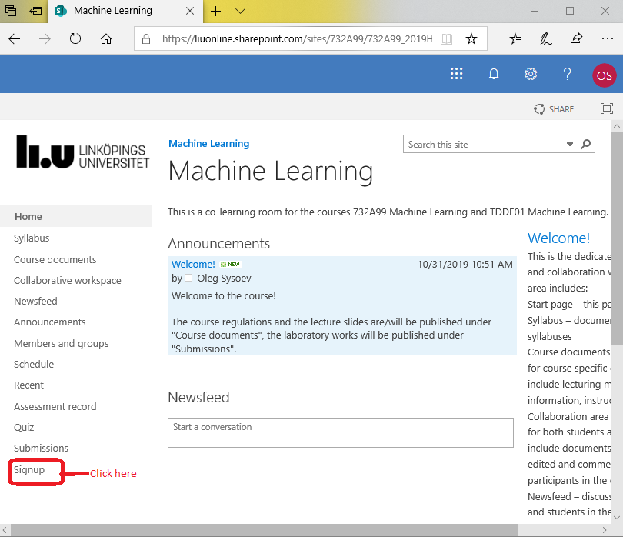
Define your group

Slide 6
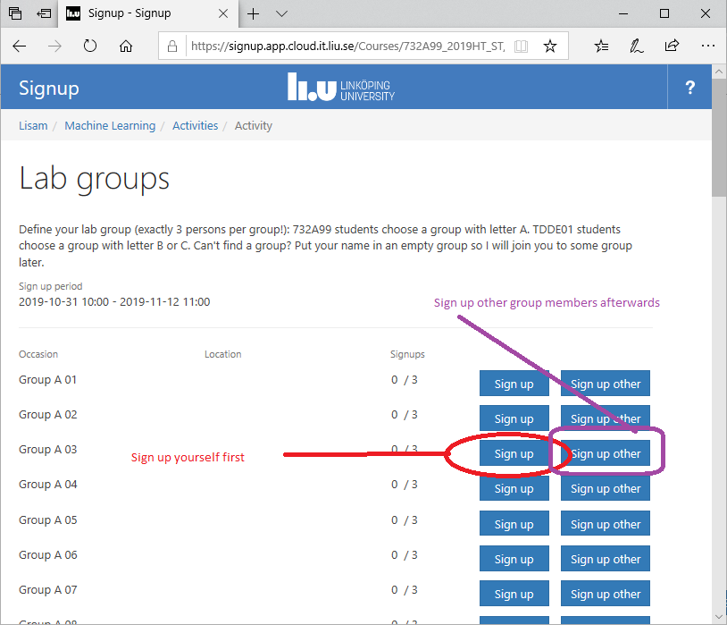
Define your group
732A99: Use any empty group with letter A
TDDE01: Use any empty group with letter B or C

Slide 7

Course organization
Examination
TDDE01, 732A99: laboratory part + computer-based exam
Lecture 1c is ’Introduction to R’
Lecture 1b is ’Basic Statistics’
http://www.swagseduction.com/wp-content/uploads/2014/11/stressful.jpg

Slide 8
What is Machine Learning ?
Machine learning is a subfield of computer science that evolved from the study of pattern recognition and computational learning theory in artificial intelligence.
Machine learning explores the study and construction of algorithms that can learn from and make predictions on data. Such algorithms operate by building a model from example inputs in order to make data-driven predictions or decisions, rather than following strictly static program instructions.
Wikipedia (Oct 15, 2016).

Slide 9
Machine Learning and Statistics
ML=intersection of computer science, statistics and artificial intelligence.
Related: data mining, knowledge discovery and data science.
ML uses mainly statistical (probabilistic) models for analyzing data .
Data mining and knowledge discovery tend to use less rigorous, but often effective, algorithms.
ML is not a discovery of a hidden information (Data Mining)
ML vs Statistics: ML has a heavier focus on prediction , and lesser on interpretation.
ML applications often involve large sets →computational complexity of algorithms is important.
Statistics often does not care about runtime

Slide 10

Why probability models?
Probability models and statistical inference provide a framework
A principled way to think about any problem in machine learning
Probabilistic model →Estimation →Prediction
Probabilistic models quantify uncertainties.
Deterministic answers may often be inappropriate
http://lolnada.org/t/src/1454993210255.jpg
The currency exchange rate tomorrow will be 10.41!

Slide 11
Why probability models?
As robotics is now moving into the open world, the issue of uncertainty has become a major stumbling block for the design of capable robot systems. Managing uncertainty is possibly the most important step towards robust real-world robot systems.
from the book Probabilistic Robotics by Thrun et al.

Slide 12
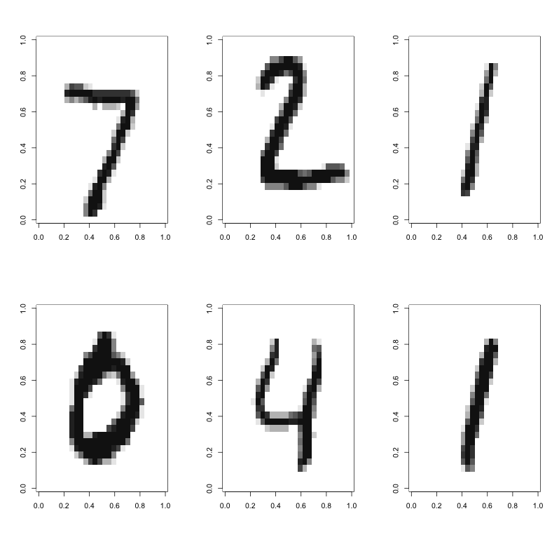
Example: classifying hadwritten digits

Slide 13
Example: classifying hadwritten digits
Training data: 60000 images.
Test data: 10000 images.
Features: intensities (0-255, scaled to 0-1) in the 28 × 28 = 784 pixels as features.
Methods:
Multinomial regression with LASSO prior
Support vector machines
Neural Networks (deep?)

Slide 14
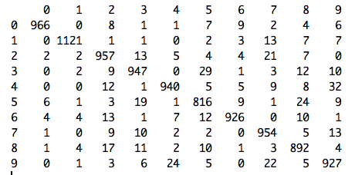
Example: classifying hadwritten digits
Confusion matrix
PREDICTION
TRUTH

Slide 15
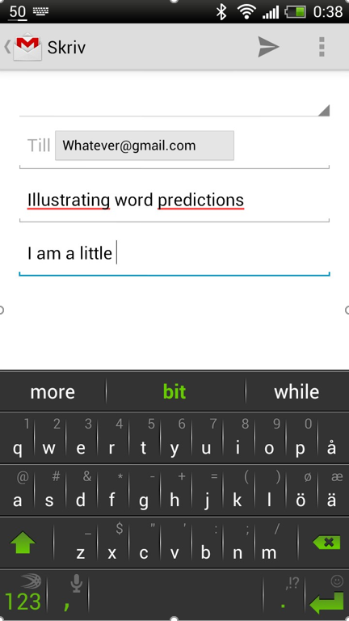
Example: smartfone typing predictions

Slide 16
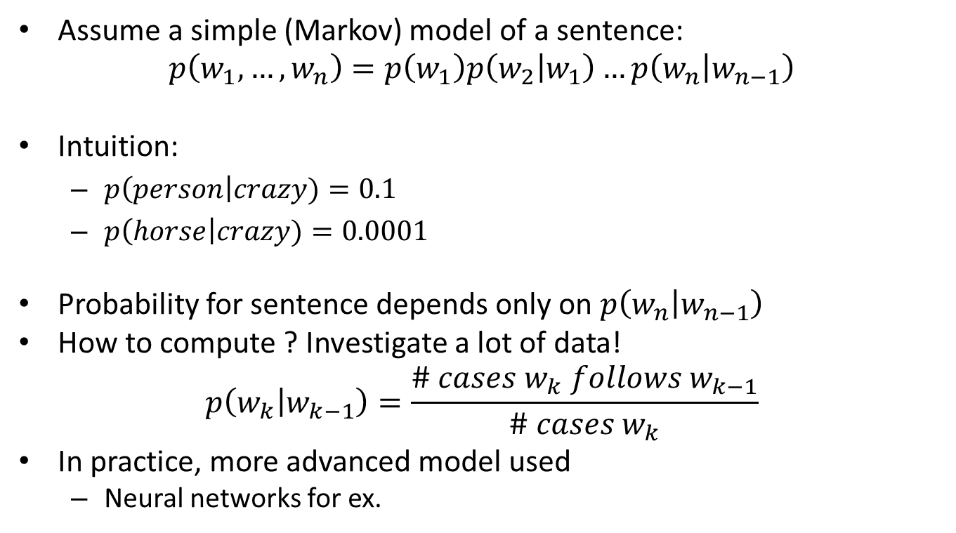
Example: smartfone typing predictions
Assume a simple (Markov) model of a sentence:
$$p\left(w_{1},…, w_{n}\right)=p\left(w_{1}\right)p\left(w_{2} | w_{1}\right)…p\left(w_{n} | w_{n−1}\right)$$
Intuition:
$p\left(person\right|crazy)=0.1$
$p\left(horse\right|crazy)=0.0001$
Probability for sentence depends only on $p\left(w_{n} | w_{n−1}\right)$
How to compute ? Investigate a lot of data!
$$p\left(w_{k} | w_{k−1}\right)=\frac{\# cases w_{k} follows w_{k−1}}{\# cases w_{k}}$$
In practice, more advanced model used
Neural networks for ex.
Highest P(?|Donald) ?

Slide 17
Types of learning
Supervised learning (classification, regression)
Compute parameters from data
Given features of a new object, predict target
Classification (Y=categorical), Regression (Y=continuous)
Most of ML models: Neural Nets, Decision Trees, Support Vector Machines, Bayesian nets
X,?
Datase =t
{Xi, Yi}
Model(?,?,?,...)
Model(a,b,c,...)
X,Y

Slide 18
Types of learning
Unsupervised learning (→Data Mining)
No target
Aim is to extract interesting information about
Relations of parameters to each other
Grouping of objects
Ex: clustering, density estimation, association analysis
X1<-> X2<-> X3...

Slide 19
Types of learning
Semi-supervised: targets are known only for some observations.
Active learning. Strategies for deciding which observations to label
Reinforcement learning. Find suitable actions to maximize the reward. True targets are discovered by trial and error.

Slide 20
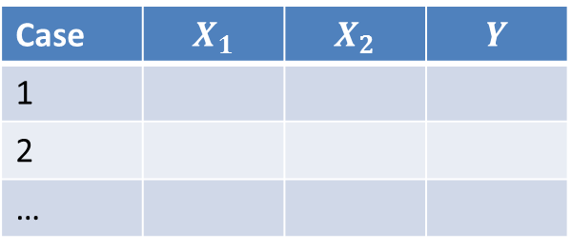
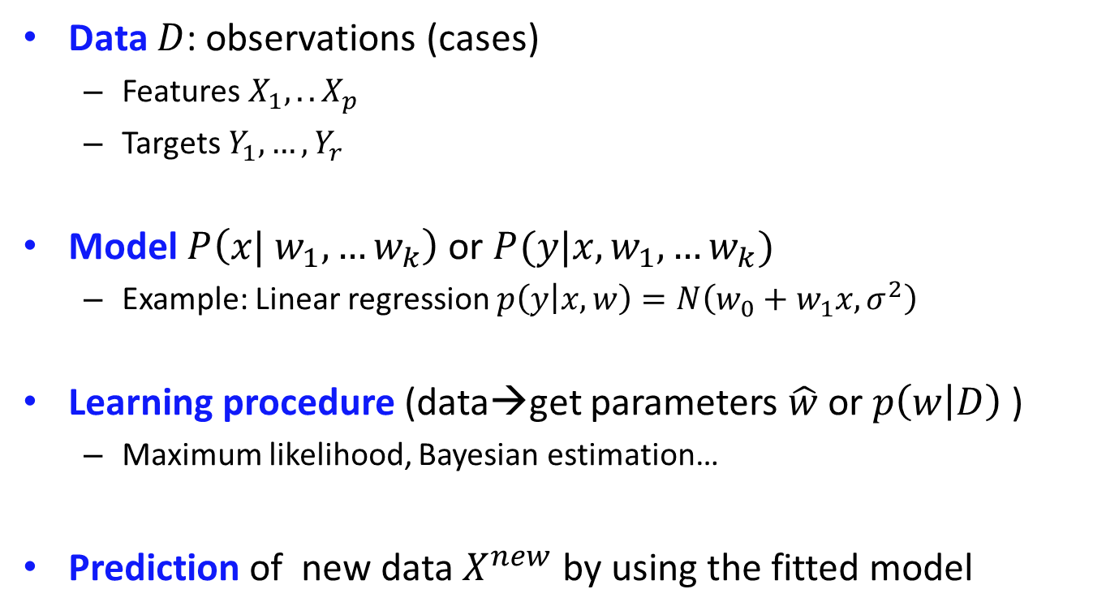
Basic ML ingridients
Data $D$: observations (cases)
Features $X_{1},.. X_{p}$
Targets $Y_{1},…{,Y}_{r}$
Model $P\left(x| w_{1},…w_{k}\right)$ or $P(y|x,w_{1},…w_{k})$
Example: Linear regression $p\left(y | x,w\right)=N\left(w_{0}+w_{1}x, σ^{2}\right)$
Learning procedure (data→get parameters $\hat{w}$ or $p\left(w | D\right)$ )
Maximum likelihood, Bayesian estimation…
Prediction of new data $X^{new}$ by using the fitted model
Case | $$X_{1}$$ | $$X_{2}$$ | $$Y$$
1
2
…

Slide 21
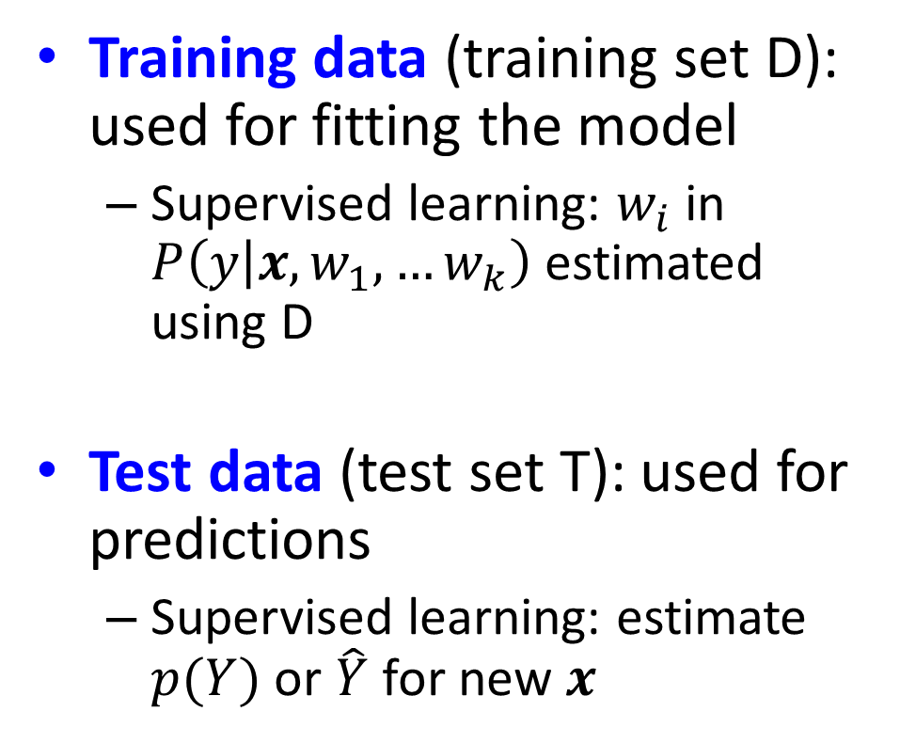
Types of data sets
Training data (training set D): used for fitting the model
Supervised learning: $w_{i}$ in $P\left(y | x,w_{1},…w_{k}\right)$ estimated using D
Test data (test set T): used for predictions
Supervised learning: estimate $p(Y)$ or $\hat{Y}$ for new $x$
X | Y
1.1 | M
2.3 | F
X | Y
1.3 | ?
2.9 | ?

Slide 22
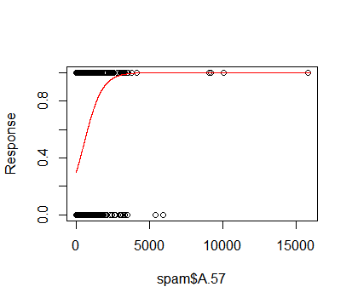
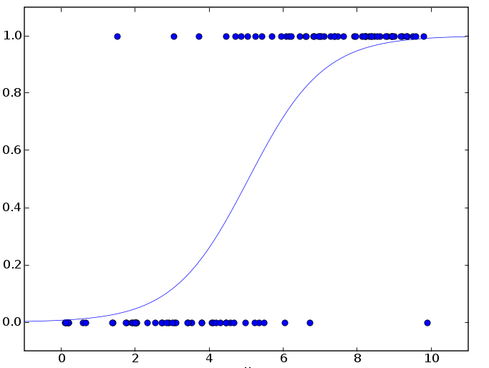

Logistic regression
Data $Y_{i}∈\left\{Spam, Not Spam\right\}, X_{i}=\#of a word$
Model: $p\left(Y=Spam | w,x\right)=\frac{1}{1+e^{−w_{0}−w_{1}X}}$
Fitting: maximum likelihood
Prediction : $p\left(spam\right)=p\left(Y=spam|x\right)$
We can also make point predictions -how?

Slide 23
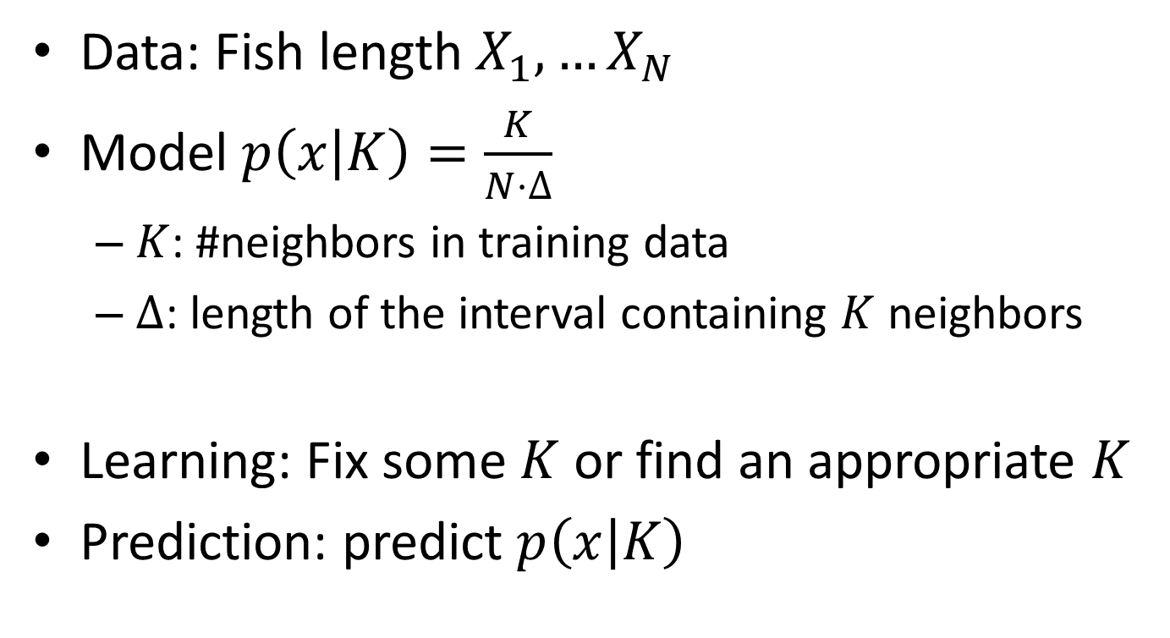
K-nearest neighbor density estimation
Data: Fish length $X_{1},…X_{N}$
Model $p\left(x | K\right)=\frac{K}{N⋅∆}$
$K$: #neighbors in training data
$∆$: length of the interval containing $K$ neighbors
Learning: Fix some $K$ or find an appropriate $K$
Prediction: predict $p\left(x | K\right)$

Slide 24
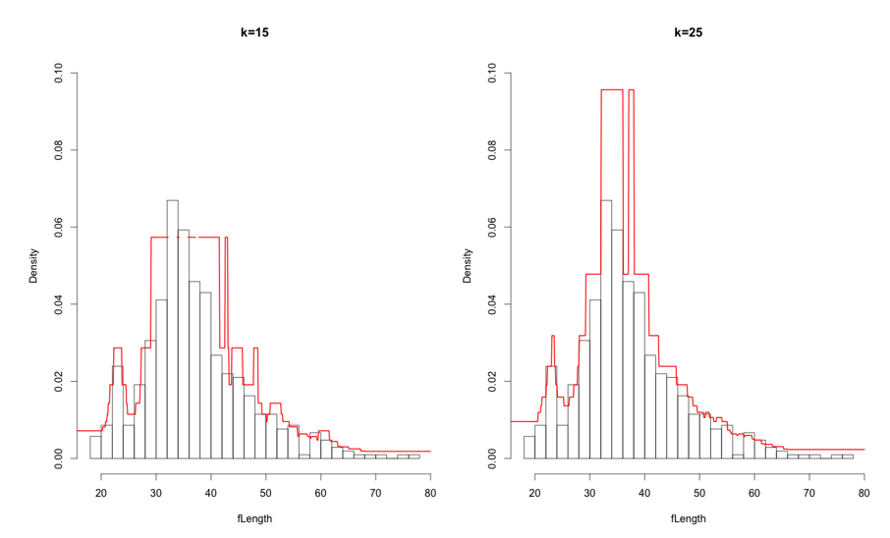
K-nearest neighbor density estimation

Slide 25
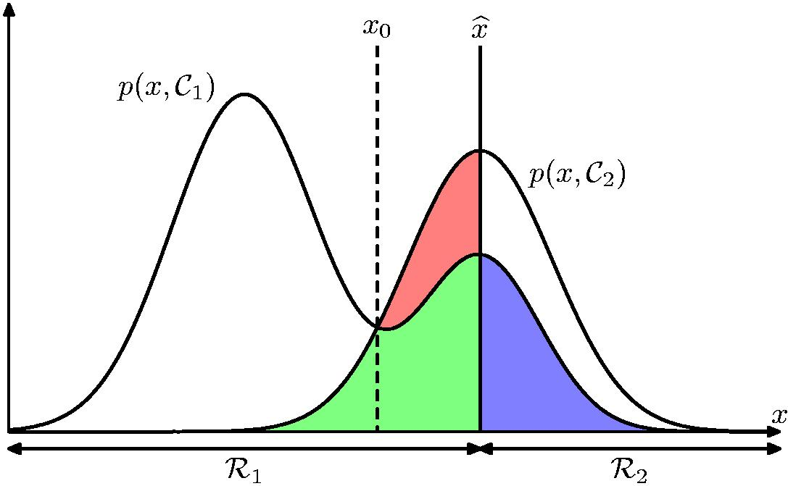

K-nearest neighbor density estimation
Why estimating a density can be interesting:
Estimate class-conditional densities $p(x|y=C_{i})$
Predict

Slide 26
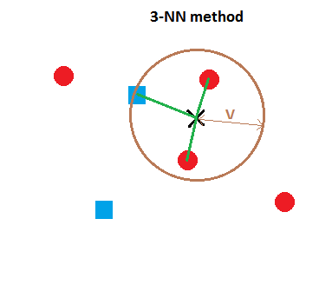
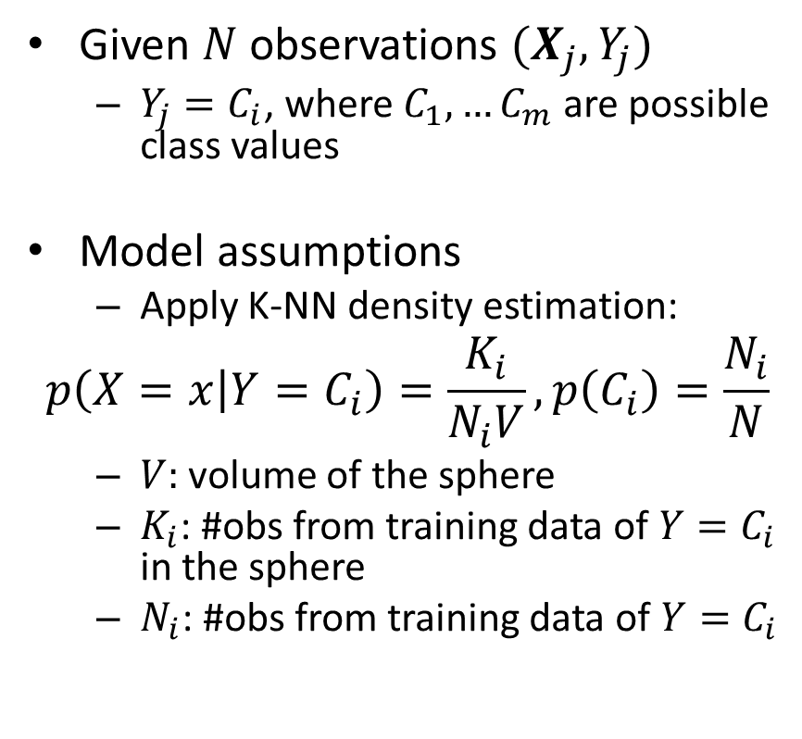
K-nearest neighbor classification
Given $N$ observations $(X_{j}, Y_{j})$
$Y_{j}=C_{i}$, where $C_{1},…C_{m}$ are possible class values
Model assumptions
Apply K-NN density estimation:
$$p\left(X=x | Y=C_{i}\right)=\frac{K_{i}}{N_{i}V}, p\left(C_{i}\right)=\frac{N_{i}}{N}$$
$V:$ volume of the sphere
$K_{i}$: #obs from training data of ${Y=C}_{i}$ in the sphere
$N_{i}$: #obs from training data of ${Y=C}_{i}$

Slide 27
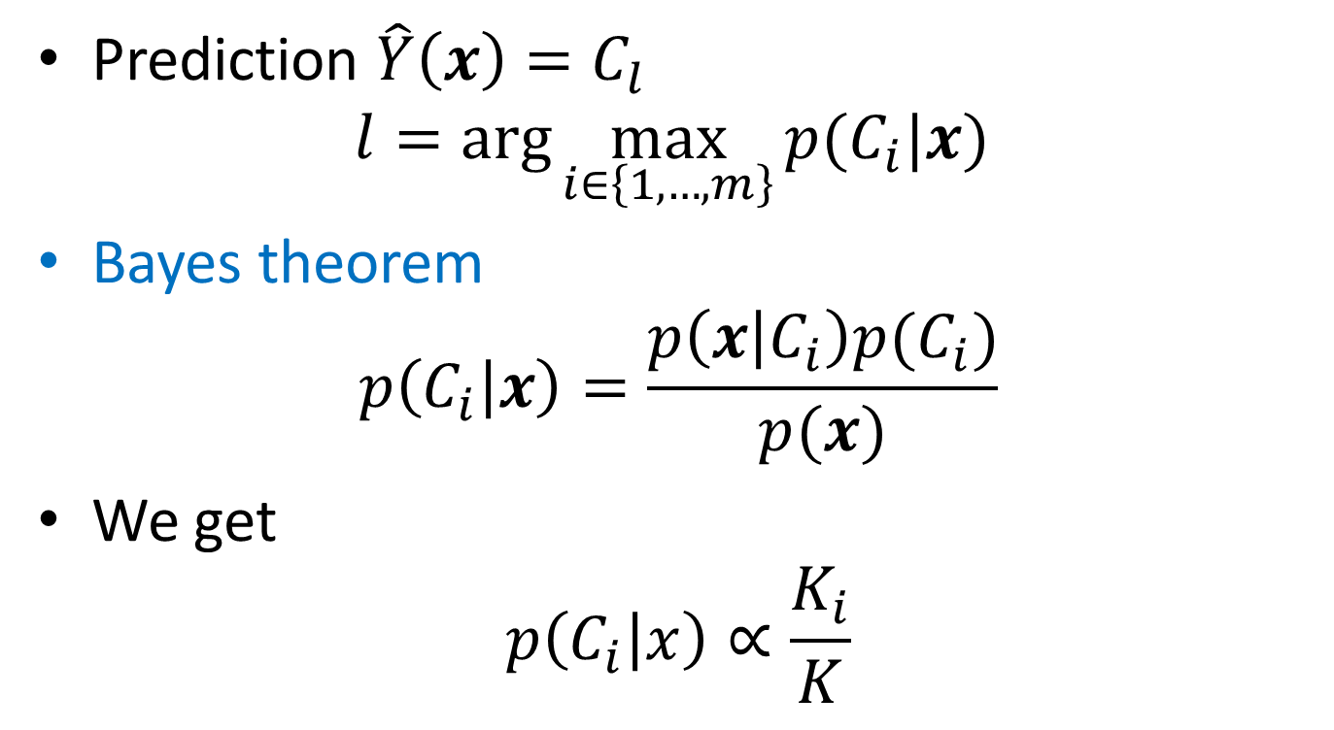
Bayesian classification
Prediction $\hat{Y}\left(x\right)=C_{l}$
$$l=\arg{\max_{i∈\left\{1,…,m\right\}}{p(C_{i}|x}) }$$
Bayes theorem
$$p\left(C_{i} | x\right)=\frac{p\left(x | C_{i}\right)p(C_{i})}{p(x)}$$
We get
$$p\left(C_{i} | x\right)∝\frac{K_{i}}{K}$$

Slide 28
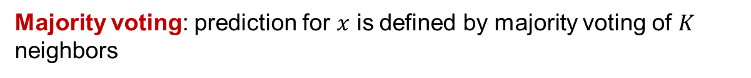

K-nearest neighbor classification
Algorithm
Given training set $D$,number $K$, and test set $T$
For each $x∈T$
For each $i=1,…M$
$p′\left(C_{i} | x\right)=\frac{K_{i}}{K}$
Compute $l=\arg{\max_{i∈\left\{1,…,m\right\}}{p′(C_{i}|x}) }$
Predict $\hat{Y}\left(x\right)=C_{l}$
Majority voting: prediction for $x$ is defined by majority voting of $K$ neighbors

Slide 29
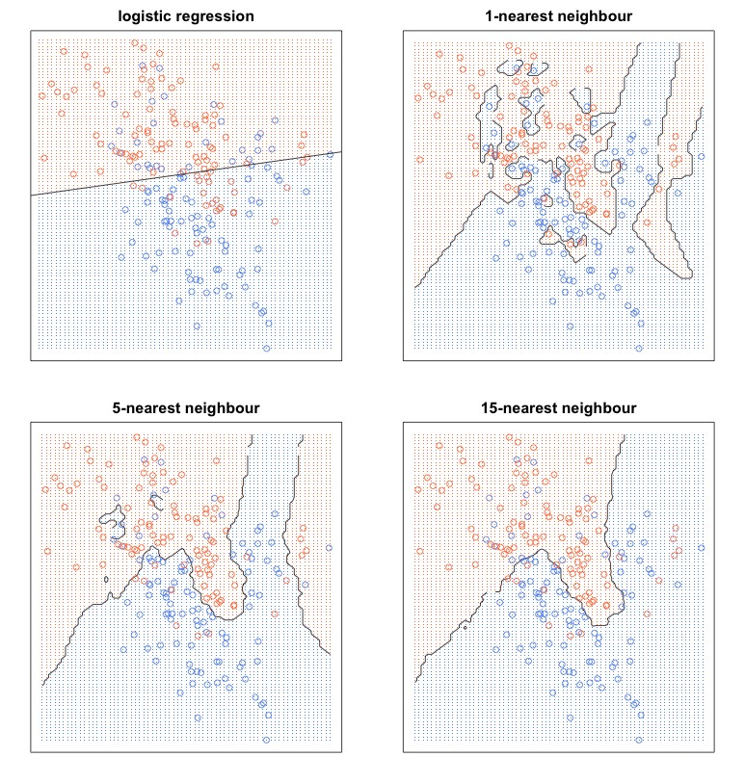
K-nearest neigbor example
Why classification results are so different for K-NN?

Slide 30
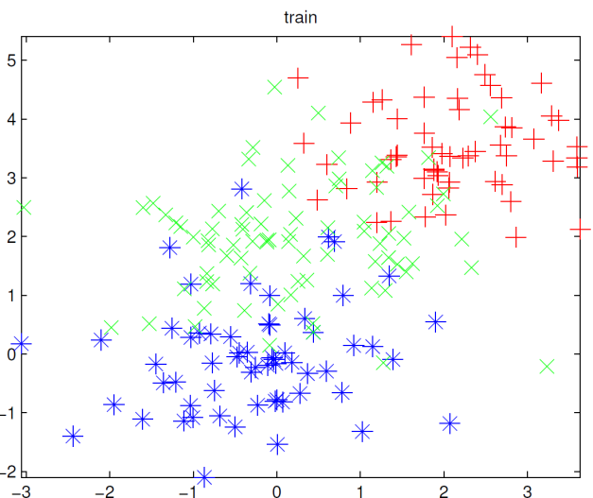
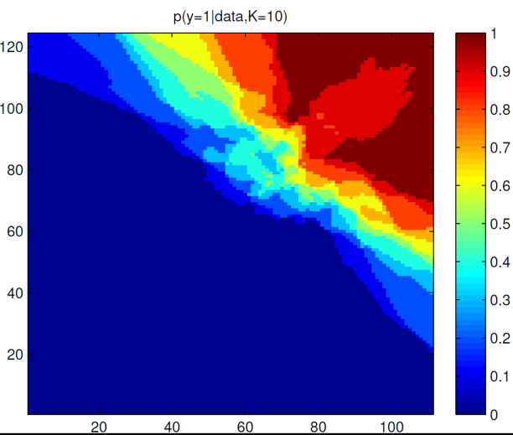
Model types
Parametric models
Have certain number of parameters independently of the size of training data
Assumption about of the data distribution
Ex: logistic regression
Nonparametric models
Number of parameters (complexity) grows with training data
Example: K-NN classifier

Slide 31
Overfitting
Which model feels appropriate?
Easy model, few parameters
Complex model,
many parameters

Slide 32
Overfitting
Now new data from the same process
Best prediction!

Slide 33
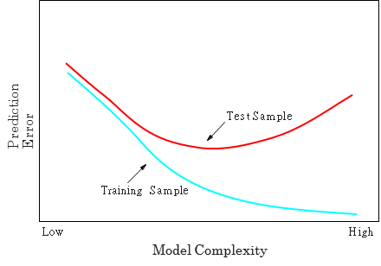
Overfitting
Observed:

Slide 34
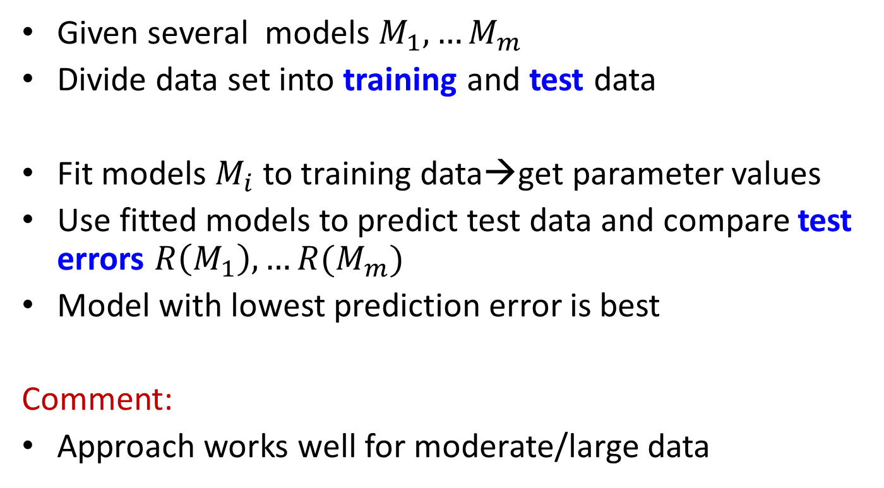
Model selection
Given several models $M_{1},…M_{m}$
Divide data set into training and test data
Fit models $M_{i}$ to training data→get parameter values
Use fitted models to predict test data and compare test errors $R\left(M_{1}\right),…R(M_{m})$
Model with lowest prediction error is best
Comment:
Approach works well for moderate/large data
Training
Test

Slide 35
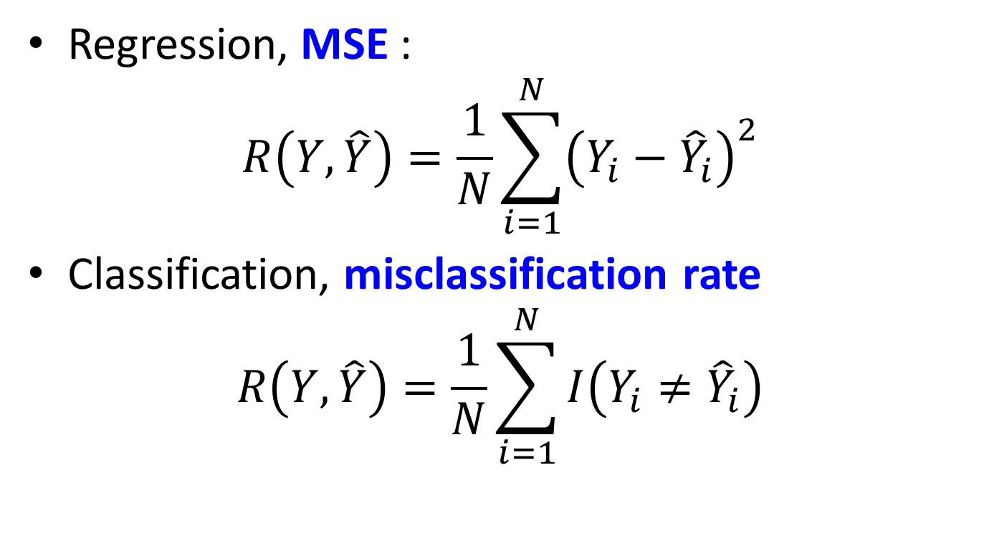
Typical error functions
Regression, MSE :
$$R\left(Y, \hat{Y}\right)=\frac{1}{N}\sum_{i=1}^{N}{{\left(Y_{i}−{\hat{Y}}_{i}\right)}^{2}}$$
Classification, misclassification rate
$$R\left(Y, \hat{Y}\right)=\frac{1}{N}\sum_{i=1}^{N}{I\left(Y_{i}≠{\hat{Y}}_{i}\right)}$$

Slide 36
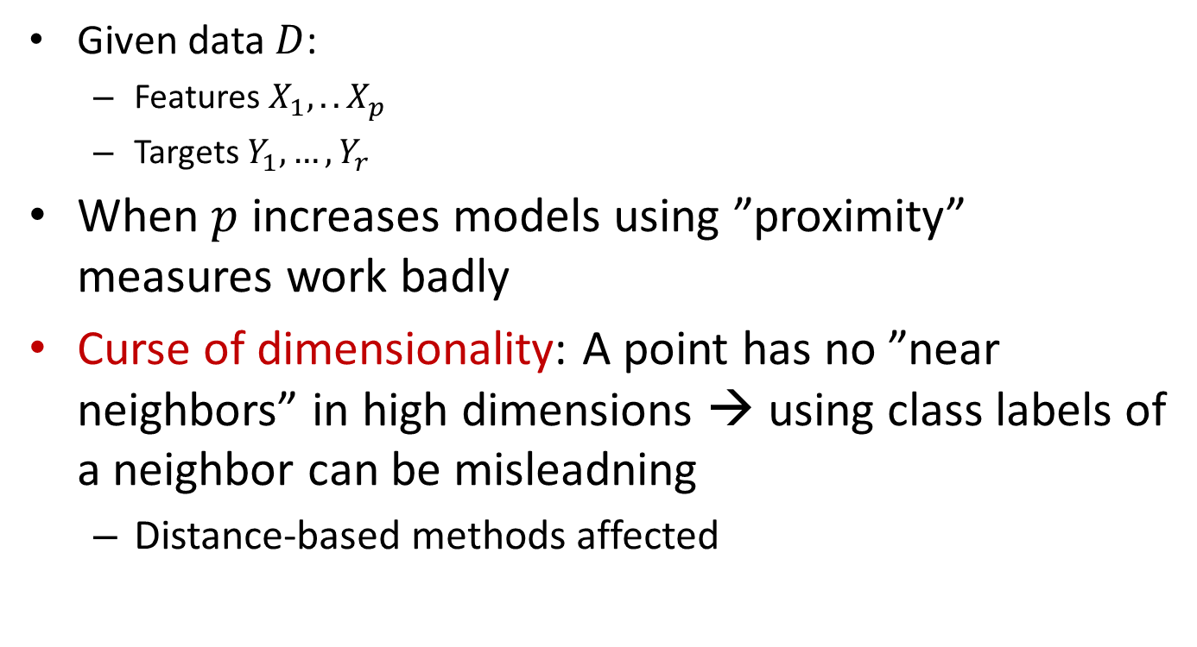
Curse of dimensionality
Given data $D$:
Features $X_{1},.. X_{p}$
Targets $Y_{1},…{,Y}_{r}$
When $p$ increases models using ”proximity” measures work badly
Curse of dimensionality: A point has no ”near neighbors” in high dimensions → using class labels of a neighbor can be misleadning
Distance-based methods affected

Slide 37
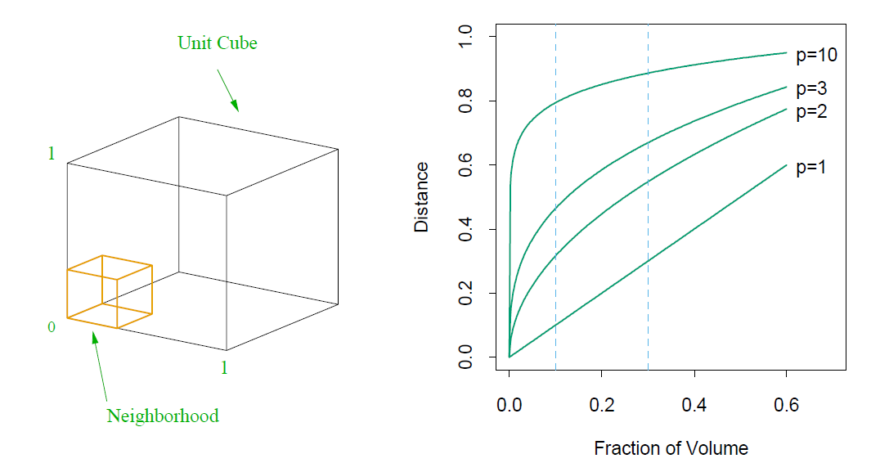
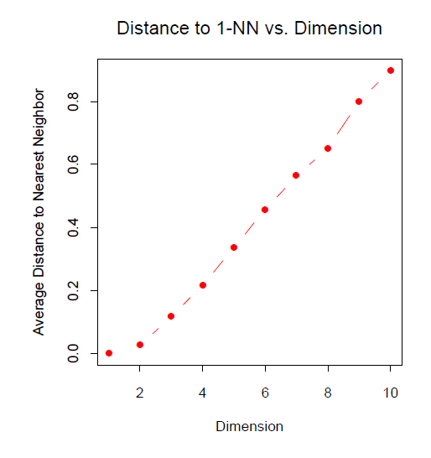
Curse of dimensionality

Slide 38
Curse of dimensionality
Hopeless? No!
Real data normally has much lower effective dimension
Dimensionality reduction techniques
Smoothness assumption
small change in one of Xs should lead to small change in Y→interpolation

